Slide 1
Advanced Concepts in Angular

Slide 2
Agenda
Bootstrap Advanced
i18n
Validation
Conclusions

Slide 3
Bootstrap Advanced

Slide 4
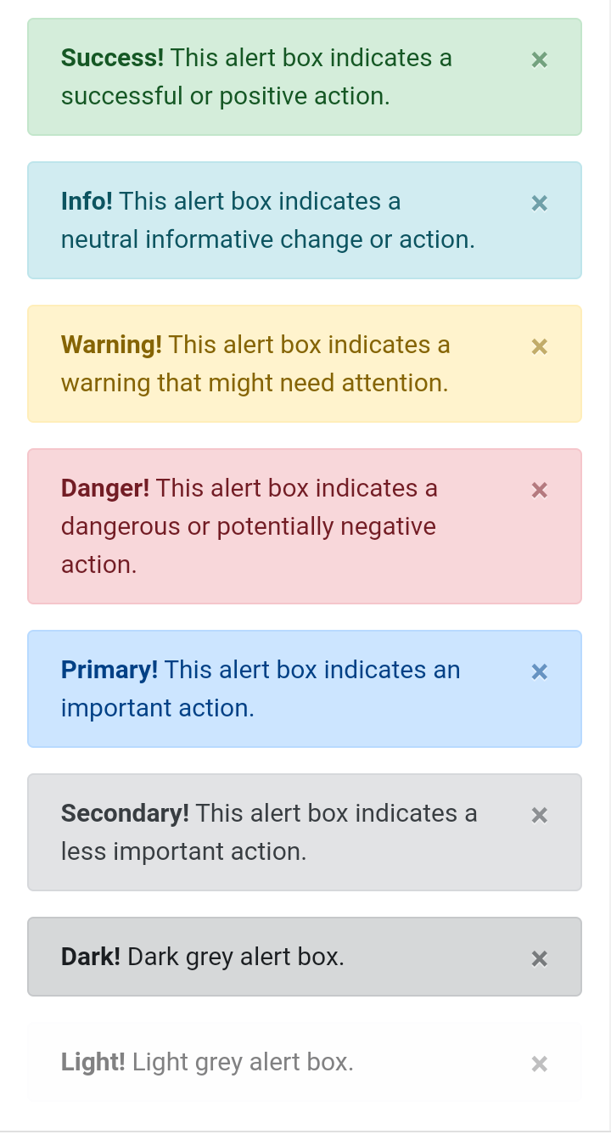
Alerts

Slide 5
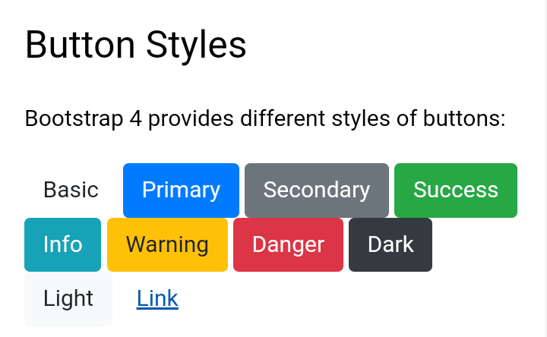
Bootstrap 4 Buttons

Slide 6
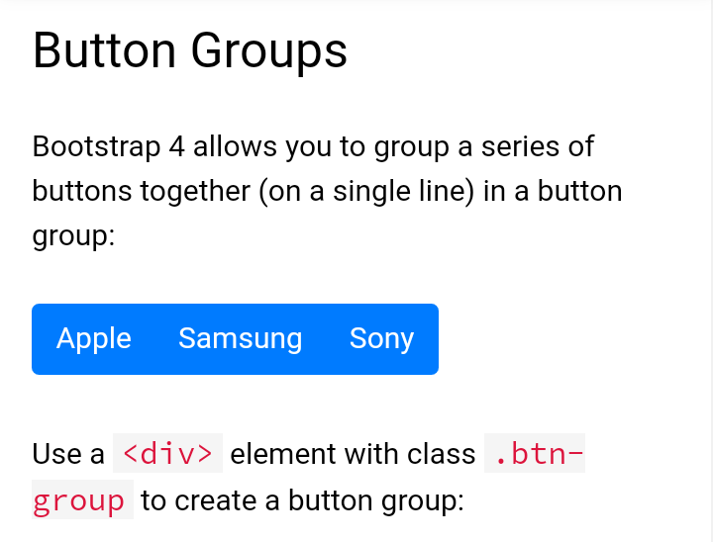
Bootstrap 4 Button Groups

Slide 7
Bootstrap 4 Badges

Slide 8
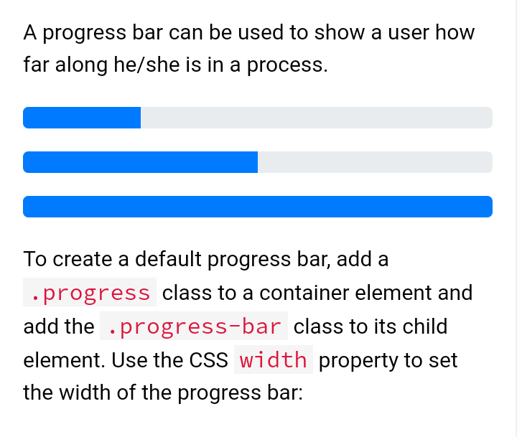
Bootstrap 4 Progress Bars

Slide 9
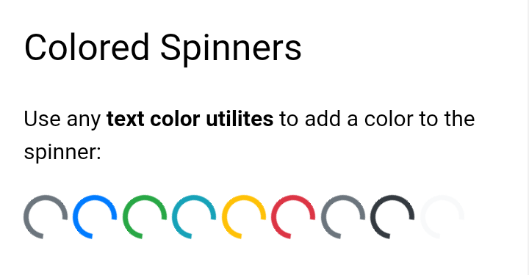
Bootstrap 4 Spinners

Slide 10
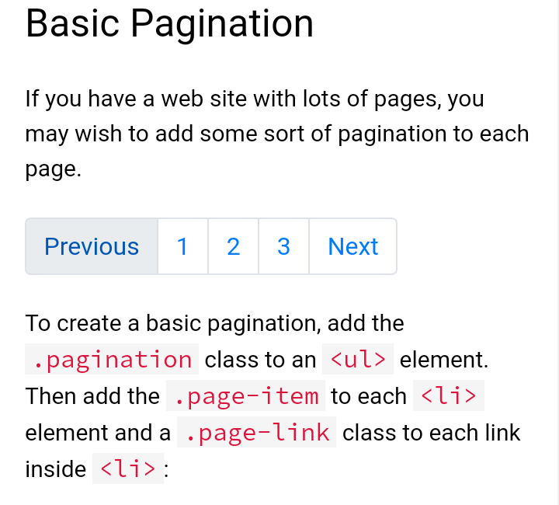
Bootstrap 4 Pagination

Slide 11
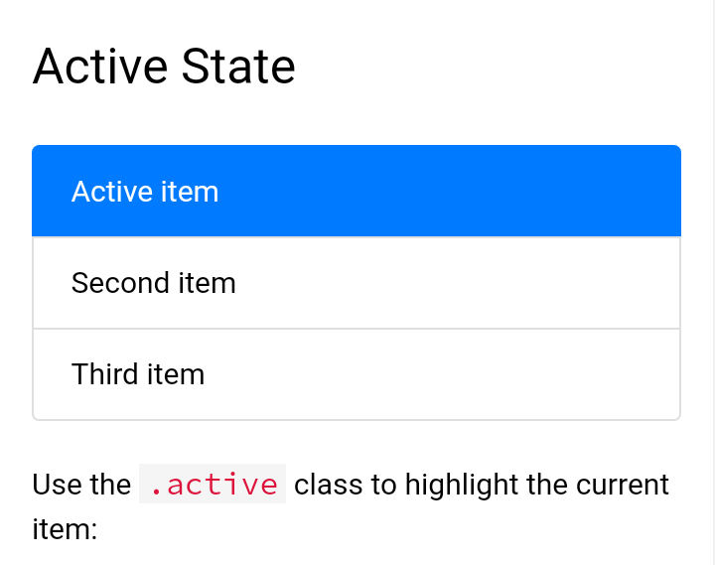
Bootstrap 4 List Groups

Slide 12
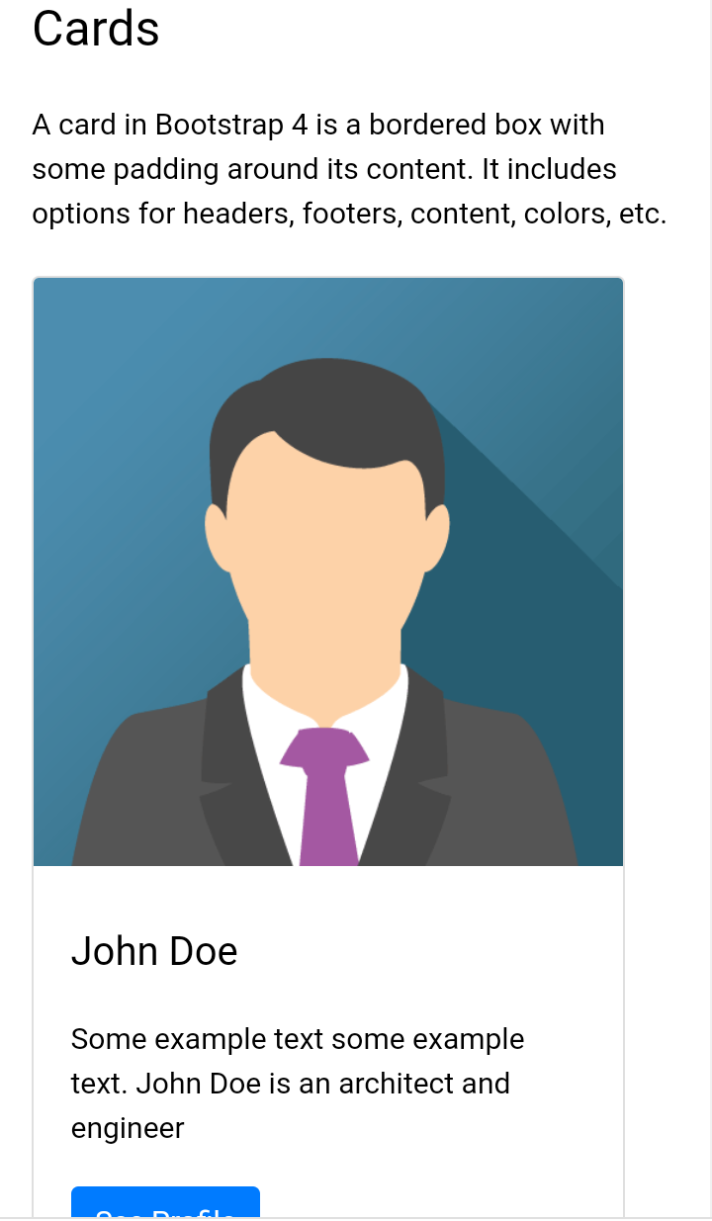
Bootstrap 4 Cards

Slide 13
Bootstrap 4 Dropdowns
Bootstrap 4 Collapse
Bootstrap 4 Navs
Bootstrap 4 Navigation Bar
Bootstrap 4 Forms
Bootstrap 4 Form Inputs
Bootstrap 4 Custom Forms

Slide 14
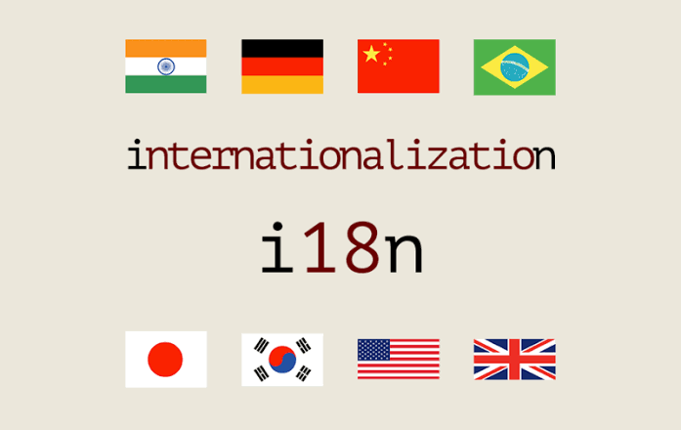
i18n

Slide 15
What Is i18n?
Internationalization (i18n) is the process of preparing software so that it can support local languages and cultural settings.
An internationalized product supports the requirements of local markets around the world, functioning more appropriately based on local norms and better meeting in-country user expectations.

Slide 16
Validation Form
Form validation is a “technical process where a web-form checks if the information provided by a user is correct.”
The form will either alert the user that they messed up and need to fix something to proceed, or the form will be validated and the user will be able to continue with their registration process.

Slide 17
Validation in Angular
You can improve overall data quality by validating user input for accuracy and completeness.
This page shows how to validate user input from the UI and display useful validation messages, in both reactive and template-driven forms

Slide 18
Thank you...

